Slide 1
Discrete Mathematics BCSC0010
Module 1
Conditional Probability

Slide 2
Probability Theorems
Addition Theorem or
Additive Law of Probability or
union of A and B
Multiplication Theorem or
Intersection of A and B

Slide 3
Addition Theorem
Case 1: If A and B are mutually exclusive events
P(A U B)=P (A or B)=P(A)+P(B)
Example
Probability of getting either 1 or 3 on single throw of die
P(1 or 3)=P(1)+P(3)
=1/6+1/6
=1/3

Slide 4
Addition Theorem
Case2: If A and B are not mutually exclusive
P(A U B)=P(A)+P(B)-P(A ⋂ B)
Example :
A bag contains 20 balls numbered 1 to 20 and a ball is drawn at random. Find probability that ball drawn will contain a number multiple of 3 or 5.
Multiple of 3, A={3,6,9,12,15,18}
Multiple of 5, B={5,10,15,20}
P(A U B)=P(A)+P(B)-P(A ⋂ B)
=6/20+4/20-1/20

Slide 5
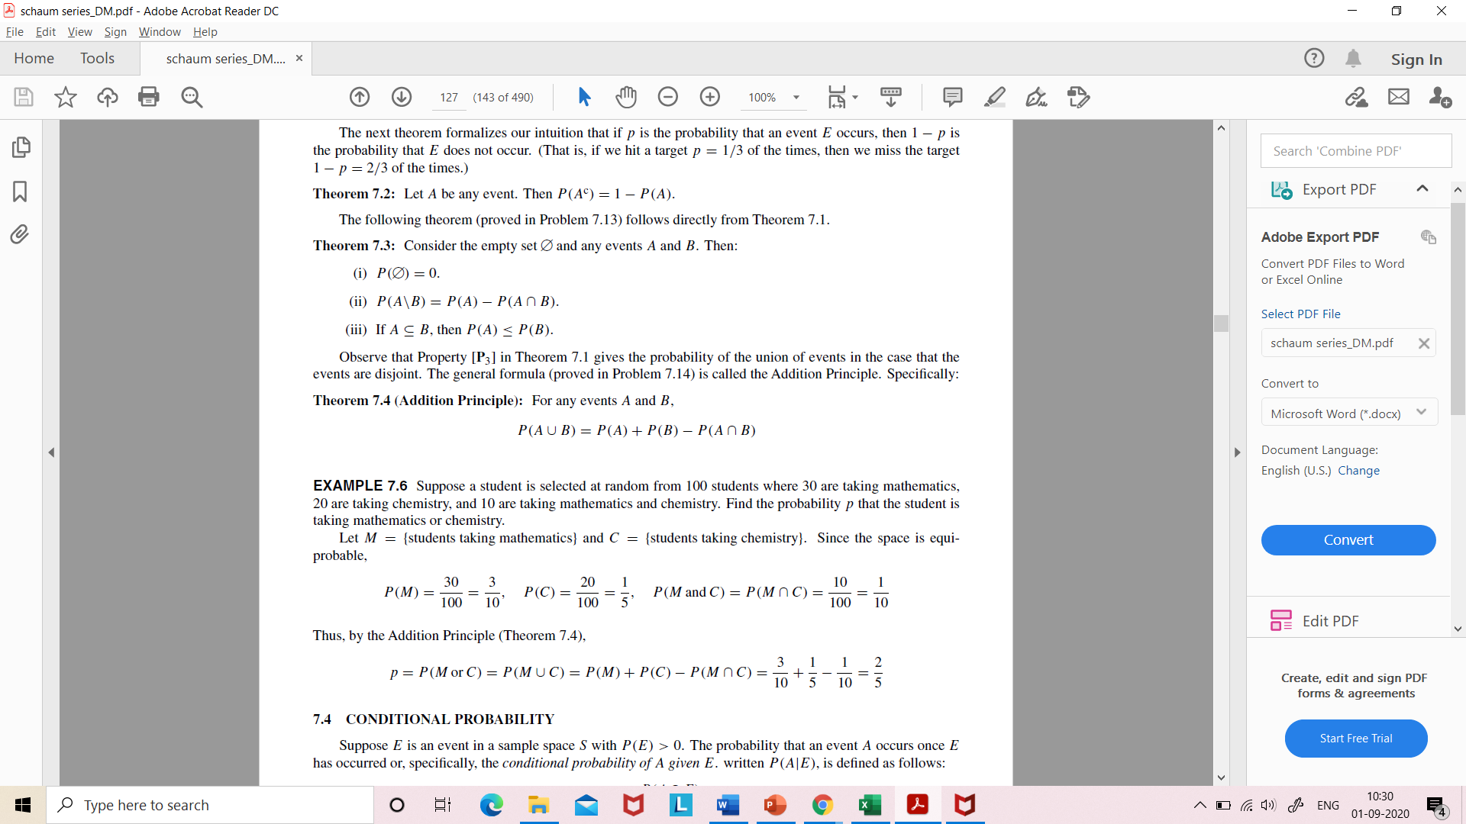
Example
Suppose a student is selected at random from 100 students where 30 are taking mathematics, 20 are taking chemistry, and 10 are taking mathematics and chemistry. Find the probability p that the student is taking mathematics or chemistry.
Let M = {students taking mathematics} and C = {students taking chemistry}
By Addition Principle,

Slide 6
Conditional Probability
Let S be the sample space and A and B be two events in S. The probability that event A occurs given that event B has occurred is defined as the conditional probability of event A given the occurrence of event B.
Denoted by P(A|B)
P(A|B)=P(A ⋂ B)/P(B) =n(A ⋂ B)/n(B)
Where P(B) > 0

